Slide 1
CS414 Rollerball - Project 3
Team Name : String Cheese
Members : Chris Schaffer, Meetkumar Savaliya,
Tim Stroup, Wei Chen , Ya-Hsin Cheng

Slide 2
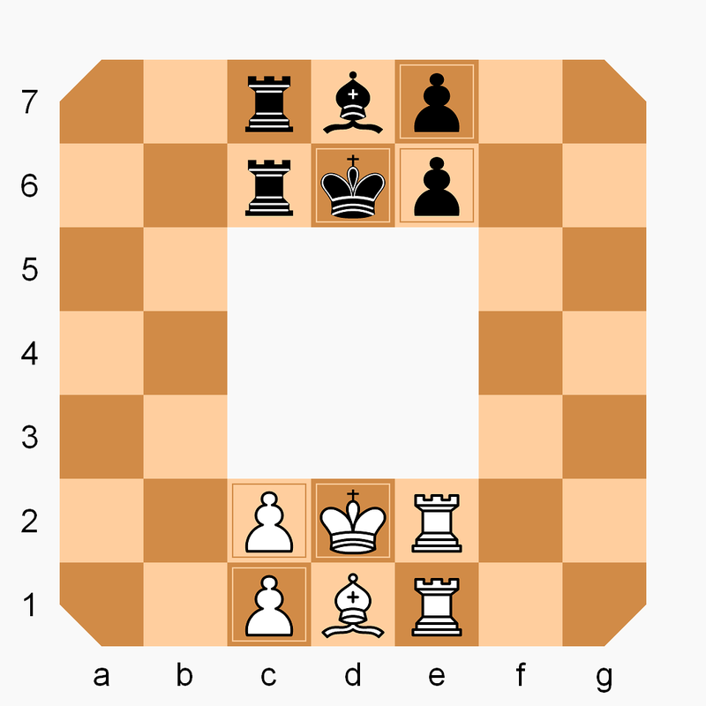
Rollerball rules
The Board
7×7 squares with the central 3×3 blanks
The Pieces
Only can move clockwise
1 King
1 Bishop
2 Rooks
2 Pawns
How to win
Checkmate the enemy king
Travel own king clockwise direction to the start position of the enemy king

Slide 3
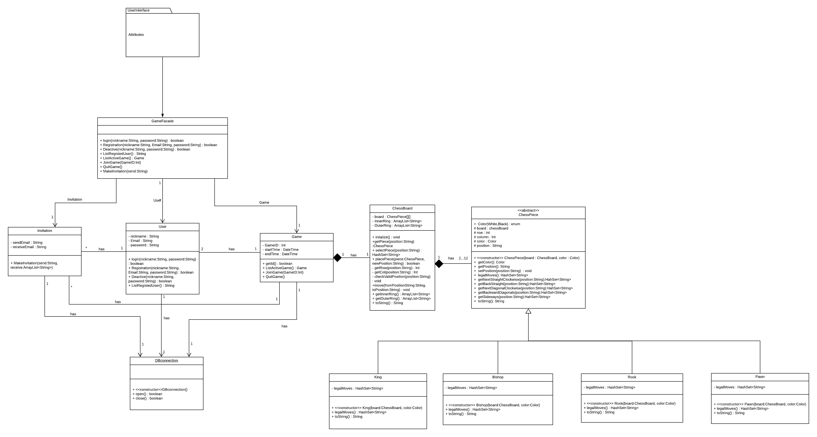
Class Diagram

Slide 4
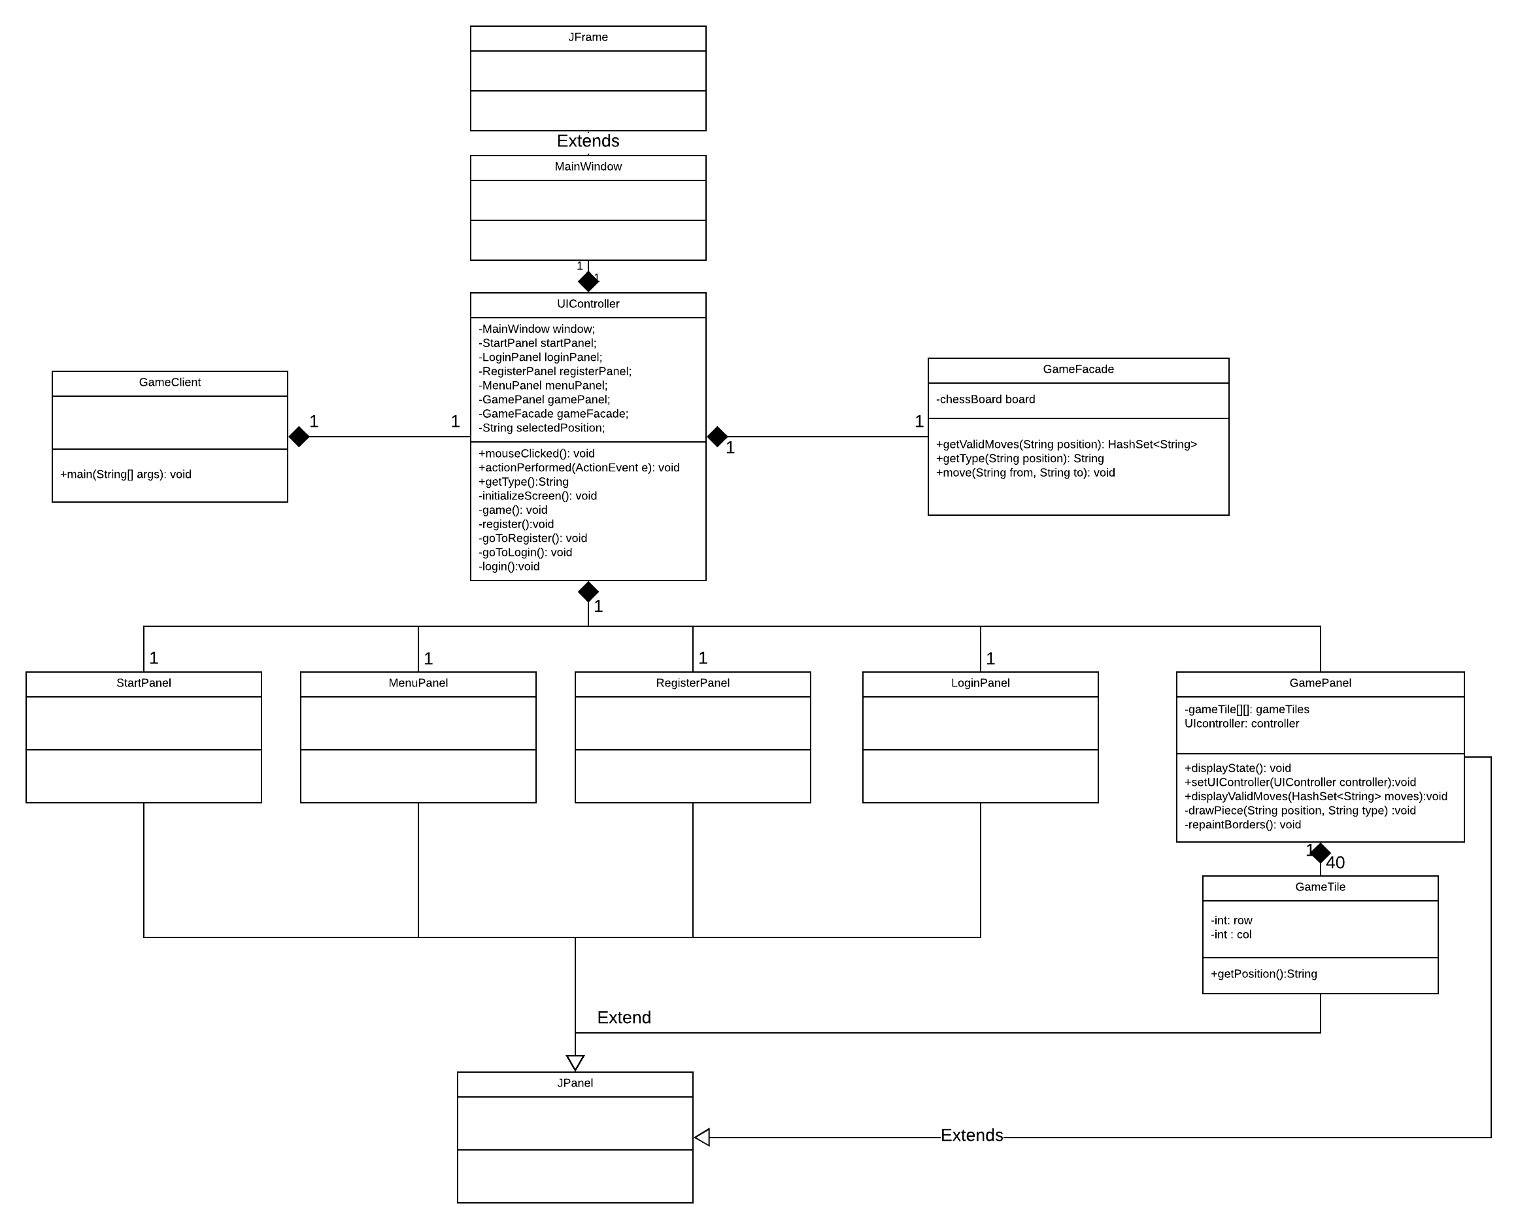
Class Diagram – UI Interface

Slide 5
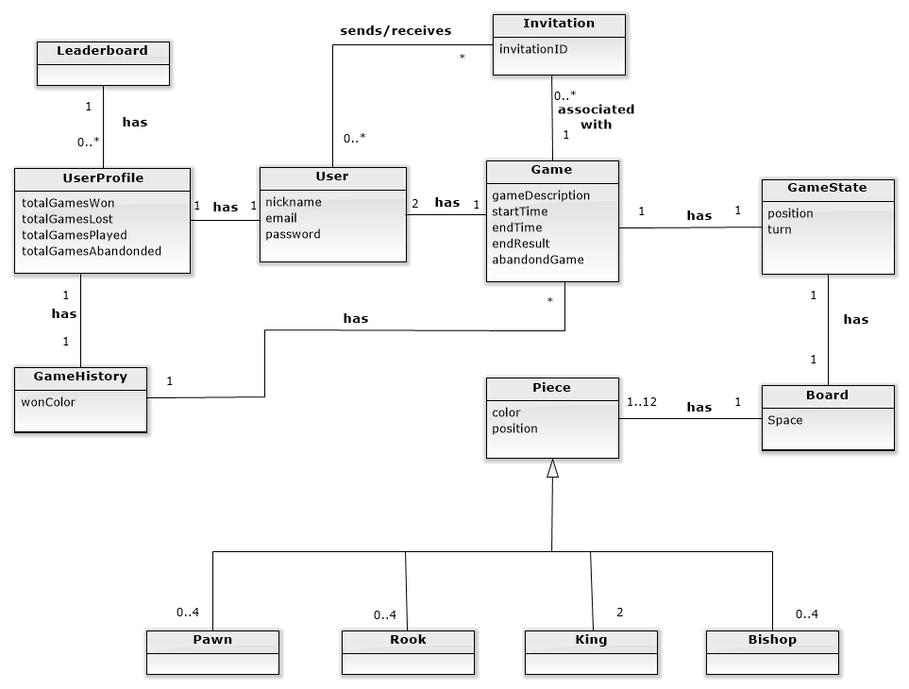
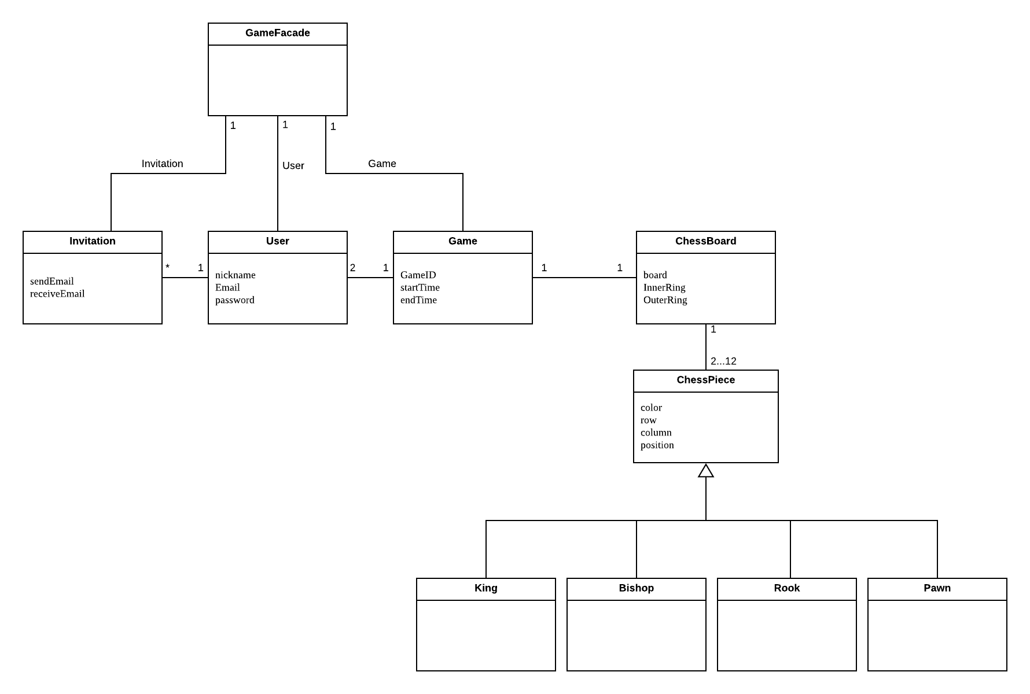
Domain Model Update
Previous one
Updated one

Slide 6
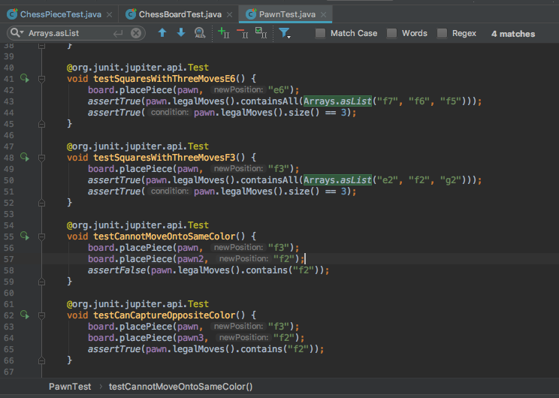
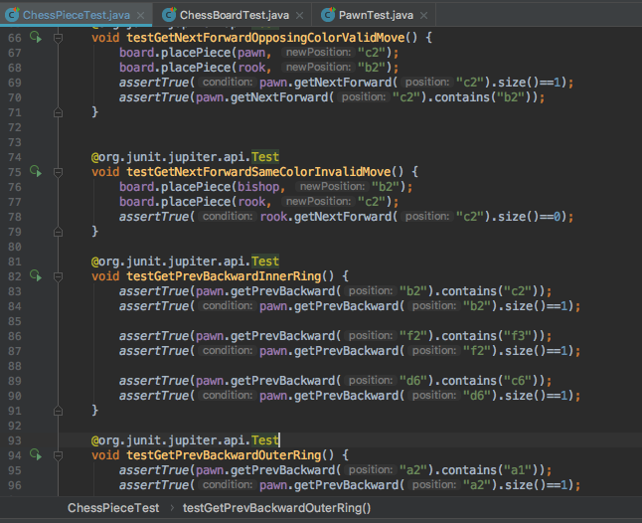
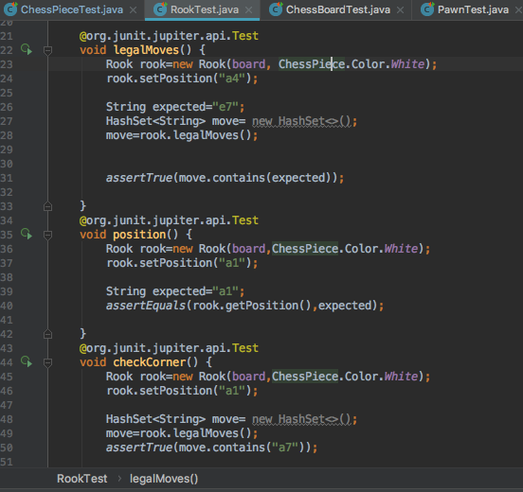
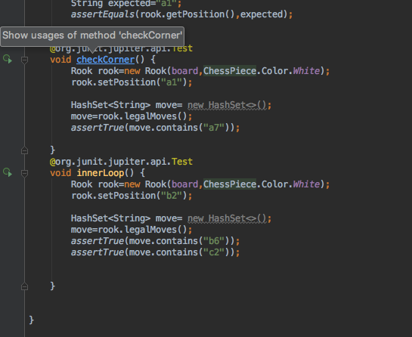

Slide 7
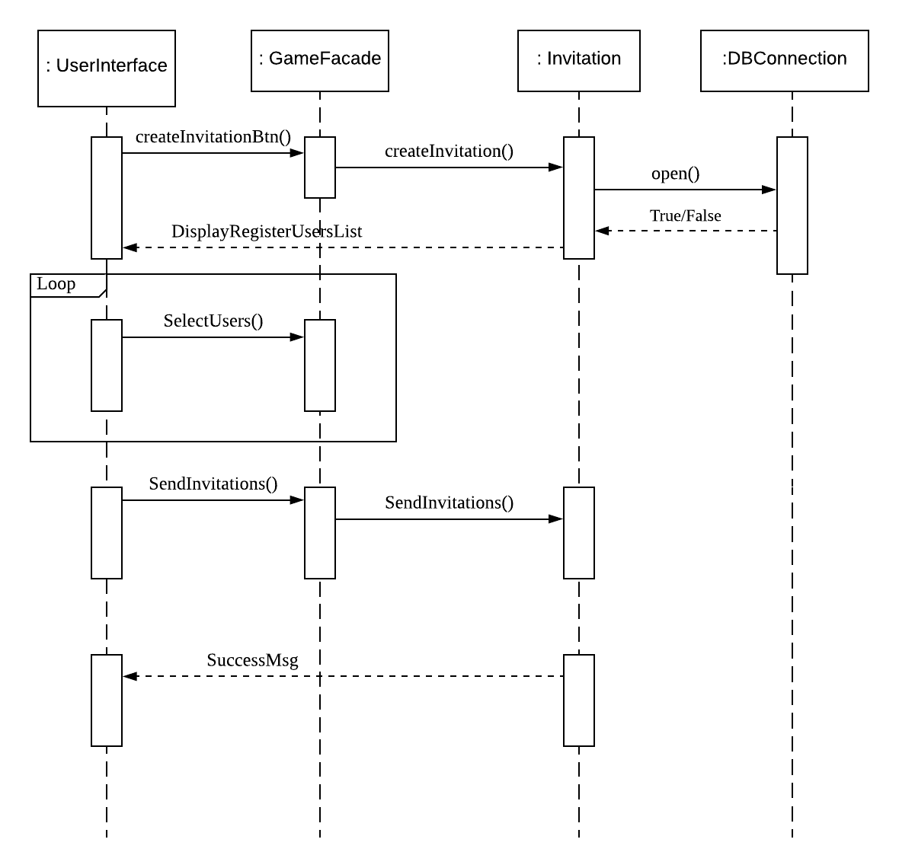
Sequence Diagram – Send Invitation

Slide 8
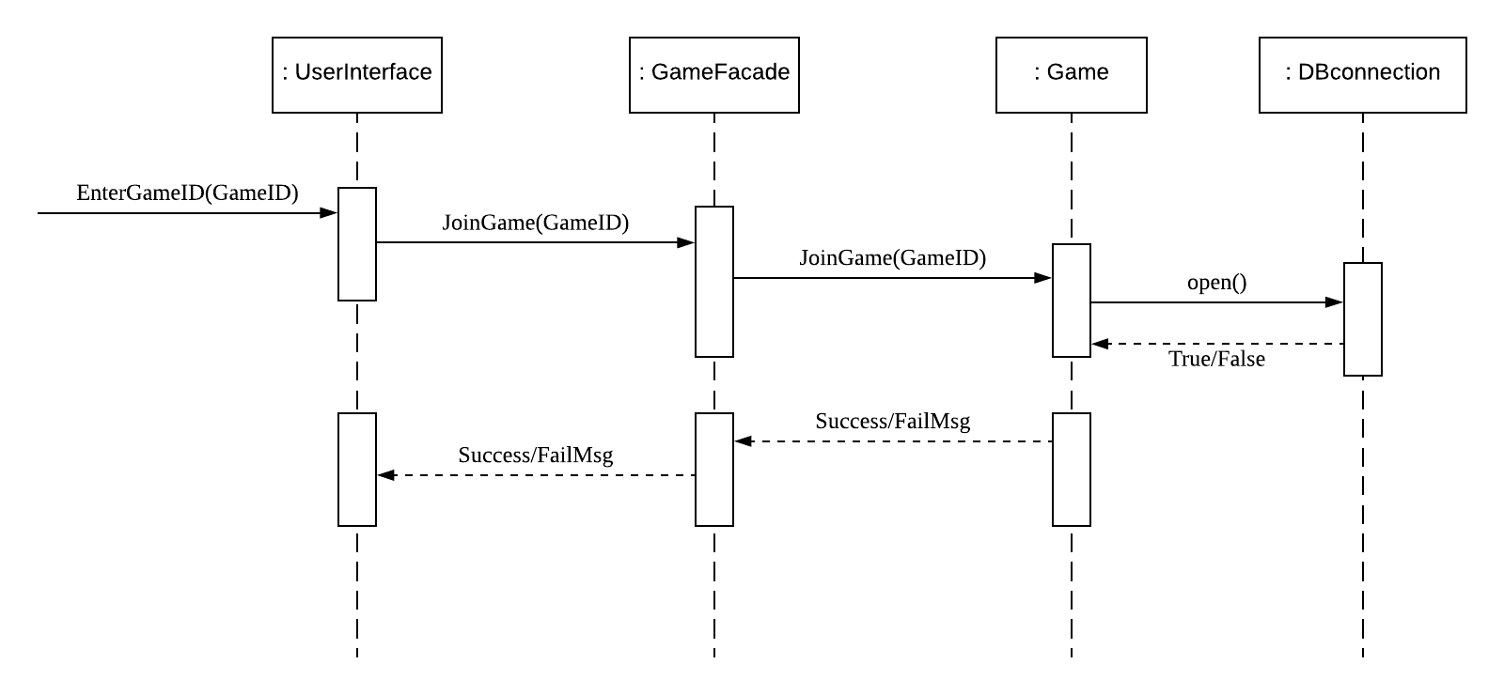
Sequence Diagram – Join Game

Slide 9
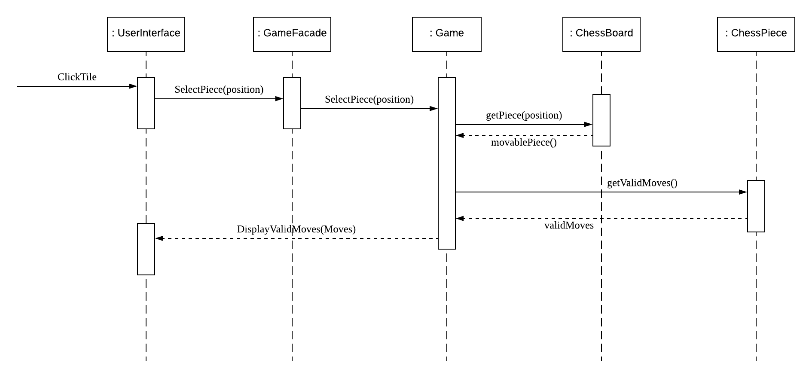
Sequence Diagram – Take Turn

Slide 10
Traceability link matrix
 | ChessBoard | ChessPiece | Game | Invitation | User | DBconnection
UC1-Register Account |  |  |  |  | X | X
UC2-Create Game |  |  | X |  |  | X
UC3-Create Invitation |  |  |  | X |  | X
UC4-Deactivate account |  |  |  |  | X | X
UC5-Join Game |  |  | X |  |  | X
UC6-View Profile |  |  |  |  | X | X
UC7-Log on |  |  |  |  | X | X
UC8-Quit game |  |  | X |  |  | X
UC9-List active games |  |  | X |  |  | X
UC10-Take Turn | X | X | X |  | X | X
UC11-Update Game State | X |  | X |  |  | X
UC12-Display Valid Moves | X | X | X |  | X

Slide 11
User |  |  |  |  |  | Comments
Field Name | Field size | Data type | Data format | Descriptiopn | Example
Nickname | 20 | varchar | Alphanumeric | primary key ,not allowed null | john,jane
Email | 30 | varchar | Email format | Not allowed null,Super key | john.doe@xyz.com
Password | 40 | varchar | Alphanumeric | Not allowed null | johndoe123,
Game
Field Name | Field size | Data type | Data format | Descriptiopn | Example
GameID | 10 | Int | Number | Primary key,Not allowed null | 100,101,102
host(Nickname) | 20 | varchar | Alphanumeric | Not allowed null | john,jane
Invitee(Nickname) | 20 | varchar | Alphanumeric | Not allowed null | john,jane
StartTime | ---- | DateTime | mm/dd/yyyy hh:mm:ss | Not allowed null | 12/10/18 12:45
EndTime | ---- | DateTime | mm/dd/yyyy hh:mm:ss | allowed null | 12/10/18 13:10 | Ending time will be decided at end and game table table entry will be created at first
Result | 20 | varchar | Alphanumeric | allowed null | john,jane
Abandon | ---- | boolean | binary | allowed null | true/false
UserProfile
Field Name | Field size | Data type | Data format | Descriptiopn | Example
Nickname | 20 | varchar | Alphanumeric | Foreign key ,not allowed null | john,jane
TotalGameWon | 10 | int | Number | default is zero,not allowed null | 102
TotalGameLost | 10 | int | Number | default is zero,not allowed null | 104
TotalGamePlayed | 10 | int | Number | default is zero,not allowed null,check constraint (playedgame=won+lost+abondoned) | 312
TotalGameAbonndoned | 10 | int | Number | default is zero,not allowed null | 106
GameHistory
Field Name | Field size | Data type | Data format | Descriptiopn | Example
Nickname | 20 | varchar | Alphanumeric | Foreign key ,not allowed null | john,jane
GameID | 10 | Int | Number | Foreign key,Not allowed null | 100,101,102
WonColour | ---- | boolean | binary | not allwed null,0-black,1-white | 0,1
Invitation
Field Name | Field size | Data type | Data format | Descriptiopn | Example
Sender Nickname | 20 | varchar | Alphanumeric | not allowed null,allowed duplicate | john,jane
Reciever Nickname | 20 | varchar | Alphanumeric | not allowed null,allowed duplicate | john,jane
Accepted invitation | ---- | boolean | binary | default is zero,accepted 1 | 0,1 | will set trigger on this column,default will be zero because whenever reciever accept the invitation ,value gets updated in this column,once value updated trigger will help us to create Game table entry.
Leaderboard(TopWinner)
Field Name | Field size | Data type | Data format | Descriptiopn | Example
Nickname | 20 | varchar | Alphanumeric | Foreign key ,not allowed null | john,jane
TotalGameWon | 10 | int | Number | not allowed null | 102 | This table will be updated by Userprofile table,and stored in descending ordered
Board
Field Name | Field size | Data type | Data format | Descriptiopn | Example
id | 10 | int | Number | auto incremented, | 0-1-2
column1 | 10 | varchar | Alphanumeric | allowed null | null/unicode
column2 | 10 | varchar | Alphanumeric | allowed null | null/unicode
column3 | 10 | varchar | Alphanumeric | allowed null | null/unicode
column4 | 10 | varchar | Alphanumeric | allowed null | null/unicode
column5 | 10 | varchar | Alphanumeric | allowed null | null/unicode
column6 | 10 | varchar | Alphanumeric | allowed null | null/unicode
column7 | 10 | varchar | Alphanumeric | allowed null | null/unicode
column8 | 10 | varchar | Alphanumeric | allowed null | null/unicode
Gid | 10 | int | Number | not allowed null | 0-1-2 | this one is for keeping the track of perticular game
Moves
Field Name | Field size | Data type | Data format | Descriptiopn | Example
Nickname | 20 | varchar | Alphanumeric | Foreign key ,not allowed null | john,jane
current location | 20 | int | Number | not allowed null | 5,10.68 | //will require to do calculation to find box number
next Location | 20 | int | Number | not allowed null | 5,10.68
Gid | 10 | int | Number | not allowed null,allows duplicate | 0-1-2
PieceID | 10 | int | Number | not allowed null,allows duplicate | 1,2,3 | //can have idea which piece moves
Piece
Field Name | Field size | Data type | Data format | Descriptiopn | Example
PieceName | 20 | varchar | Alphanumeric | primary key ,not allowed null | king,rook,etc
PieceID | 10 | int | Number | not allowed null,Must be unique | 1,2,3

Slide 12
User |  |  |  |  |  | Comments
Field Name | Field size | Data type | Data format | Descriptiopn | Example
Nickname | 20 | varchar | Alphanumeric | primary key ,not allowed null | john,jane
Email | 30 | varchar | Email format | Not allowed null,Super key | john.doe@xyz.com
Password | 40 | varchar | Alphanumeric | Not allowed null | johndoe123,
Game
Field Name | Field size | Data type | Data format | Descriptiopn | Example
GameID | 10 | Int | Number | Primary key,Not allowed null | 100,101,102
host(Nickname) | 20 | varchar | Alphanumeric | Not allowed null | john,jane
Invitee(Nickname) | 20 | varchar | Alphanumeric | Not allowed null | john,jane
StartTime | ---- | DateTime | mm/dd/yyyy hh:mm:ss | Not allowed null | 12/10/18 12:45
EndTime | ---- | DateTime | mm/dd/yyyy hh:mm:ss | allowed null | 12/10/18 13:10 | Ending time will be decided at end and game table table entry will be created at first
Result | 20 | varchar | Alphanumeric | allowed null | john,jane
Abodon | ---- | boolean | binary | allowed null | true/false
UserProfile
Field Name | Field size | Data type | Data format | Descriptiopn | Example
Nickname | 20 | varchar | Alphanumeric | Foreign key ,not allowed null | john,jane
TotalGameWon | 10 | int | Number | default is zero,not allowed null | 102
TotalGameLost | 10 | int | Number | default is zero,not allowed null | 104
TotalGamePlayed | 10 | int | Number | default is zero,not allowed null,check constraint (playedgame=won+lost+abondoned) | 312
TotalGameAbonndoned | 10 | int | Number | default is zero,not allowed null | 106
GameHistory
Field Name | Field size | Data type | Data format | Descriptiopn | Example
Nickname | 20 | varchar | Alphanumeric | Foreign key ,not allowed null | john,jane
GameID | 10 | Int | Number | Foreign key,Not allowed null | 100,101,102
WonColour | ---- | boolean | binary | not allwed null,0-black,1-white | 0,1
Invitation
Field Name | Field size | Data type | Data format | Descriptiopn | Example
Sender Nickname | 20 | varchar | Alphanumeric | not allowed null,allowed duplicate | john,jane
Reciever Nickname | 20 | varchar | Alphanumeric | not allowed null,allowed duplicate | john,jane
Accepted invitation | ---- | boolean | binary | default is zero,accepted 1 | 0,1 | will set trigger on this column,default will be zero because whenever reciever accept the invitation ,value gets updated in this column,once value updated trigger will help us to create Game table entry.
Leaderboard(TopWinner)
Field Name | Field size | Data type | Data format | Descriptiopn | Example
Nickname | 20 | varchar | Alphanumeric | Foreign key ,not allowed null | john,jane
TotalGameWon | 10 | int | Number | not allowed null | 102 | This table will be updated by Userprofile table,and stored in descending ordered
Board
Field Name | Field size | Data type | Data format | Descriptiopn | Example
id | 10 | int | Number | auto incremented, | 0-1-2
column1 | 10 | varchar | Alphanumeric | allowed null | null/unicode
column2 | 10 | varchar | Alphanumeric | allowed null | null/unicode
column3 | 10 | varchar | Alphanumeric | allowed null | null/unicode
column4 | 10 | varchar | Alphanumeric | allowed null | null/unicode
column5 | 10 | varchar | Alphanumeric | allowed null | null/unicode
column6 | 10 | varchar | Alphanumeric | allowed null | null/unicode
column7 | 10 | varchar | Alphanumeric | allowed null | null/unicode
column8 | 10 | varchar | Alphanumeric | allowed null | null/unicode
Gid | 10 | int | Number | not allowed null | 0-1-2 | this one is for keeping the track of perticular game
Moves
Field Name | Field size | Data type | Data format | Descriptiopn | Example
Nickname | 20 | varchar | Alphanumeric | Foreign key ,not allowed null | john,jane
current location | 20 | int | Number | not allowed null | 5,10.68 | //will require to do calculation to find box number
next Location | 20 | int | Number | not allowed null | 5,10.68
Gid | 10 | int | Number | not allowed null,allows duplicate | 0-1-2
PieceID | 10 | int | Number | not allowed null,allows duplicate | 1,2,3 | //can have idea which piece moves
Piece
Field Name | Field size | Data type | Data format | Descriptiopn | Example
PieceName | 20 | varchar | Alphanumeric | primary key ,not allowed null | king,rook,etc
PieceID | 10 | int | Number | not allowed null,Must be unique | 1,2,3

Slide 13
Technologies and Tools
Programming Language:
Java
Programming Environment:
IntelliJ IDEA
Testing:
Travis Continuous Integration
Other:
GitHub
Developing Manual

Slide 14
DEMO

Slide 15
Q & A

